Slide 1
Online Algorithm

Slide 2
Online Algorithm
Work without full knowledge of the future
Deal with a sequence of events
Future events are unknown to the algorithm
The algorithm has to deal with one event at each time. The next event happens only after the algorithm is done dealing with the previous event

Slide 3
We compare the behavior of the on-line algorithm to an optimal off-line algorithm “OPT” which is familiar with the sequence
The off-line algorithm knows the exact properties of all the events in the sequence

Slide 4
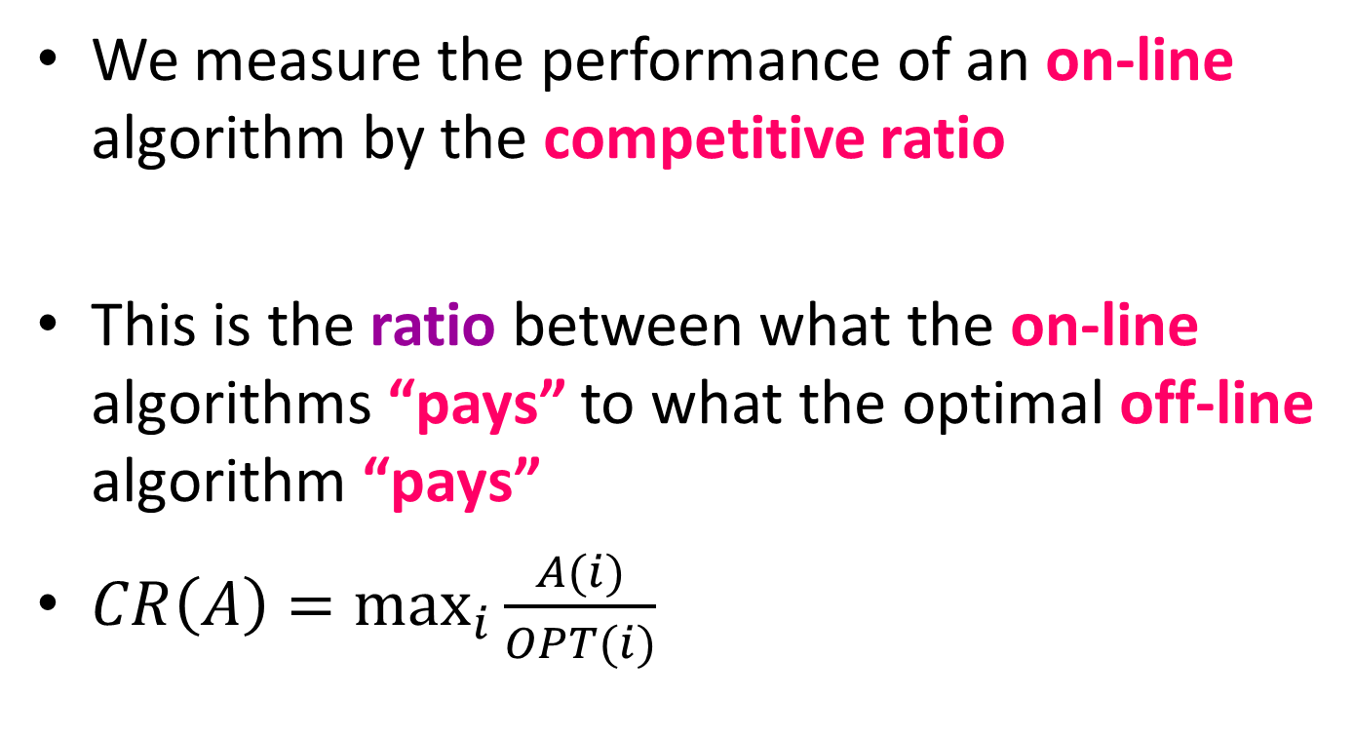
We measure the performance of an on-line algorithm by the competitive ratio
This is the ratio between what the on-line algorithms “pays” to what the optimal off-line algorithm “pays”
$CR\left(A\right)=\max_{i}{\frac{A(i)}{OPT(i)}}$

Slide 5
Ski Rental Problem
This is a rent/buy problem.
You are going skiing for an unknown number of days. Assume that renting skis costs 500 Taka per day and buying costs 1500 Taka. Every day you have to decide whether to continue renting skis for one more day or buy a pair of skis. If you know in advance how many days you will go skiing, you can decide your minimum cost. The question is what to do when you do not know in advance how many days you will ski.

Slide 6
Algorithms
Algorithm1: Always rent
Algorithm2: Buy at the first day
Algorithm3: Rent for first two days and buy on the third day

Slide 7
Algorithm 1

Slide 8
Algorithm 2

Slide 9
Algorithm 3

Slide 10
Problem Formulation
There is a number of days d (unknown to you) that you will ski. We are looking for an algorithm that minimizes the ratio between what you pay using the algorithm (that does not know d) and what you would pay optimally if you knew d in advance. The problem is generally analyzed in the worst case, where the algorithm is fixed and then we look at the worst-case performance of the algorithm over all possible d.

Slide 11
Consider a skier who at each day needs to either rent skis for Taka 1 or buy a pair of skis for Taka T which he can use for the rest of the ski season.
Offline Algorithm:
Rent if the length of the season is < T and buy otherwise.

Slide 12
Online strategy
Buying on the first day (k = 1)
Claim: This strategy is T-Competitive

Slide 13
On line strategy
Rent for (T - 1) days and buy on the T^{th} day
This algorithm is (2 - ¹/_{T})-Competitive

Slide 14
On line strategy
Rent for (T - 1) days and buy on the T^{th} day
This algorithm is (2 - ¹/_{T})-Competitive

Slide 15
Linear List Search
Given a set of items in a list where the cost of accessing an item is proportional to the distance from the head of the list i.e. a linked list, and a request sequence of accesses, the problem is to come up with a strategy of reordering the list so that the total cost of access is minimized.

Slide 16
Linear List Search
Input: Initial list, l = (1, 2, 3, .., n) and sequence of requests i₁, i₂, i₃…
Action: Search item i_{j}
Goal: minimize the total cost
Strategy: move the access item forward
Linked list -> toward head
How many position?

Slide 17
Algorithm 1
Strategy: Move the accessed item forward by 2 positions.
List: 1, 2, 3, .., n
Requests: n, n, n, n, …. (n times)
Cost: n + (n-2) + (n-4) + …….=

Slide 18
Algorithm 1
Strategy: Move the accessed item forward by 2 positions.
List: 1, 2, 3, .., n
Requests: n, n, n, n, …. (n times)
Cost: n + (n-2) + (n-4) + …….= cn²
Optimal: n +1 + 1+ ….+1= 2n-1 <2n
CR > cn/2
CR=> infinite if n=> infinite

Slide 19
Algorithm 2
Strategy: Move to front
After accessing an item move it to the front of the list without changing the order of other items

Slide 20
Algorithm 2
Strategy: Move To Front (MTF)
After accessing an item move it to the front of the list without changing the order of other items
Theorem: MTF has a CR of 2.0
Proof: We do not know the optimal algorithm but we need to compute CR

Slide 21
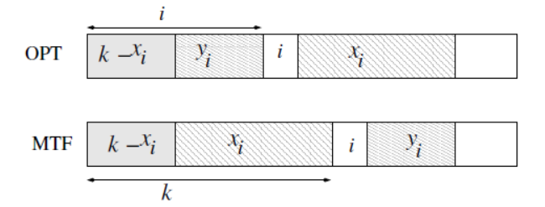
Algorithm 2
We compare two algorithms: OPT (which we do not know) and MTF
At the beginning:
OPT: 1, 2, 3, ……, n
MTF: 1, 2, 3, …., n
At step j: The cost of MTF is k

Slide 22
Algorithm 2
x_{i}: number of item which are after i in OPT and before i in MTF list
y_{i}: number of item which are before i in OPT and after i in MTF list

Slide 23
Algorithm 2
Amortized cost, T(j) = k + INV(j+1) - INV(j)
INV(j): number of item pairs (a, b) such that the order of a and b is different between the OPT and the MTF lists at time j.
OPT: ………a…..b……
MTF: ………b……a…..

Slide 24
Algorithm 2
T(j) = k + (k-x_{i} + y_{i}-α) – (x_{i} +y_{i})
=2k – 2x_{i}- α
<= 2k – 2x_{i}
<= 2i
Cost of optimal is at most i.
T(1) = k₁ + INV(2) – INV(1)
T(2) = K₂ + INV(3) – INV(2)
.
.
T(m) = k_{m}+ INV(m+1) – INV(m)

Slide 25
Algorithm 2
T(1) + T(2) + …+T(m) = k₁+ k₂ + …..+k_{m} + INV(m+1) – INV(1)
In the initial step INV(1) = 0
K₁+k₂+….+k_{m} = T(1) + T(2)+ …+T(m) –INV(m+1)
<=T(1) + T(2) + …+T(m)
<=2OPT

Slide 26
No algorithm has CR better than 2
Consider an algorithm A.
Consider an adversary against A
Request sequence is generated by adversary
(n, x1, x2…)
1 2 3 …… n
What is the worst case cost

Slide 27
Cost of optimal algorithm
Consider there is a sequence of request σ = x1, x2, …., xm for which the at most cost is mn/2
Now we consider offline algorithm O who knows σ. We do not know, how does O work? How ever we can prove that for any Input sequence σ, there exists O such that the cost is ≤ nm/2. Generate all possible permutation of requests. At least one permutation gives the optimal solution. For a given σ, computes a best permutation π of (1, n) and does not change it all.

Slide 28
Theorem: No algorithm for the linear list search problem has a CR better than 2 −2/(n+1) , where n is the number of items in the list.
Proof: Consider any online algorithm A and also consider an adversary” playing against A. The adversary gives A malicious requests. Let the item in the lists be labeled as 1, 2, 3, ・ ・ ・ , n and they are in this order in the initial list. Let the malicious requests be σ = x1(= n), x2, ・ ・ ・ , xm, where xi is the last element in the list at step I and the algorithm executes m steps. Then the cost of the algorithm is mn.
We now consider an offline algorithm O which knows the sequence σ = x1(=n), x2, ・ ・ ・ , xm in advance. Although we do not know how does O work, we can prove that for any input sequence σ, there exists an algorithm O such that its cost is at most m(n+1)/2

Slide 29
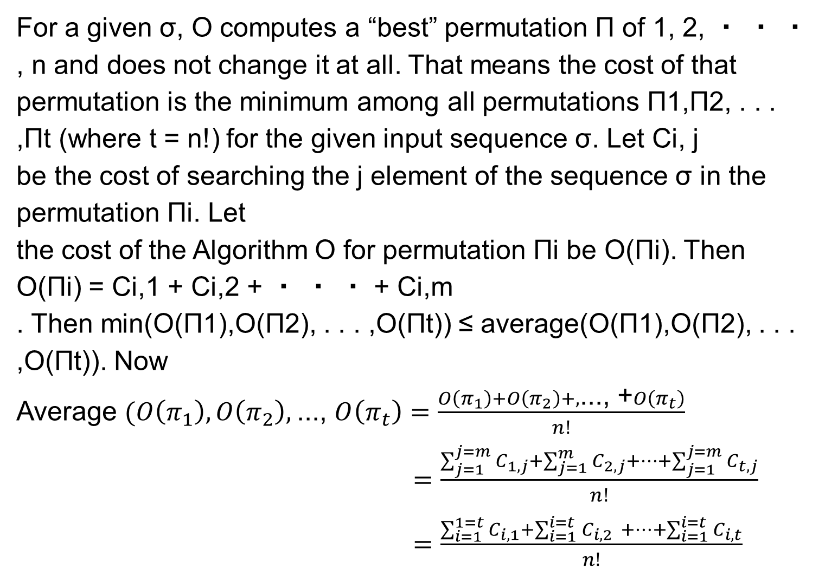
For a given σ, O computes a “best” permutation Π of 1, 2, ・ ・ ・ , n and does not change it at all. That means the cost of that permutation is the minimum among all permutations Π1,Π2, . . . ,Πt (where t = n!) for the given input sequence σ. Let Ci, j
be the cost of searching the j element of the sequence σ in the permutation Πi. Let
the cost of the Algorithm O for permutation Πi be O(Πi). Then
O(Πi) = Ci,1 + Ci,2 + ・ ・ ・ + Ci,m
. Then min(O(Π1),O(Π2), . . . ,O(Πt)) ≤ average(O(Π1),O(Π2), . . . ,O(Πt)). Now
Average $(O\left(π_{1}\right), O\left(π_{2}\right),$..., $O\left(π_{t}\right)=\frac{O\left(π_{1}\right)+O\left(π_{2}\right)+, \text{..., }\text{+}O\left(π_{t}\right)}{n!}$
$=\frac{\sum_{j=1}^{j=m}{C_{1, j}+\sum_{j=1}^{m}{C_{2, j}+…+\sum_{j=1}^{j=m}{C_{t, j}}}}}{n!}$
$=\frac{\sum_{i=1}^{1=t}{C_{i, 1}+\sum_{i=1}^{i=t}{C_{i,2 }+…+\sum_{i=1}^{i=t}{C_{i, t}}}}}{n!}$

Slide 30
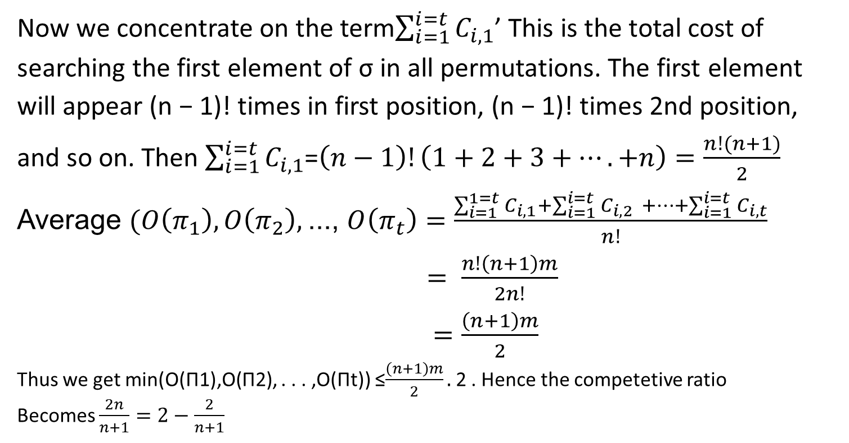
Now we concentrate on the term$\sum_{i=1}^{i=t}{C_{i, 1}}$’ This is the total cost of searching the first element of σ in all permutations. The first element will appear (n − 1)! times in first position, (n − 1)! times 2nd position, and so on. Then $\sum_{i=1}^{i=t}{C_{i, 1}}$=$\left(n−1\right)!\left(1+2+3+….+n\right)=\frac{n!(n+1)}{2}$
Average $(O\left(π_{1}\right), O\left(π_{2}\right),$..., $O\left(π_{t}\right)=\frac{\sum_{i=1}^{1=t}{C_{i, 1}+\sum_{i=1}^{i=t}{C_{i,2 }+…+\sum_{i=1}^{i=t}{C_{i, t}}}}}{n!}$
$= \frac{n!\left(n+1\right)m}{2n!}$
$=\frac{\left(n+1\right)m}{2}$
Thus we get min(O(Π1),O(Π2), . . . ,O(Πt)) ≤$\frac{\left(n+1\right)m}{2}.$2 . Hence the competetive ratio
Becomes $\frac{2n}{n+1}=2−\frac{2}{n+1}$

